Slide 1
CARVER EARLY COLLEGE Go Team Meeting January 12, 2022 4:30 p.m.
We are Creative, Compassionate and Courageous.
We are Carver Early College.
Notes:
z

Slide 2
Instructional Framework: APS Five
Curriculum
Data
Personalized Learning
SEL
Signature Programming

Slide 3
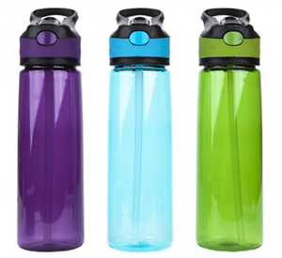
What are the safety expectations for students?
Water fountains have been disabled. Students must bring their own water bottle from home, filled before school each day, and marked with their name. A bottle-filling station is available.
Each day, students must bring:
Facial Mask
Student Device (Chromebook/laptop)
Headphones (available upon request)
Water bottle

Slide 4
Maintaining a Healthy Environment
High touch common areas will be wiped down and disinfected twice daily.
Deep cleaning of facilities will occur when students and staff are not present in buildings.
Teachers will schedule time at the end of the instructional period for routine cleaning and disinfection prior to class change.
Sharing of students’ materials and supplies will be prohibited whenever possible.
Students will minimize the amount of items brought to school each day.
Equipment and supplies that must be shared will be disinfected between uses.
Signage in common areas such as classrooms, hallways and entrances promoting good hygiene measures are posted throughout the campus as a reminder.
Students’ personal belongings will remain with them at their assigned desks and contained within their backpacks. Coats will be placed on the back of the students’ desks.
Student devices must be brought to and from school daily.

